Slide 1



University Master's Degree in Data Science
Open Data and Knowledge Graphs Course
Group 5 Assignment
Water Quality in London
Presented by:
Alejandro Cobo Cabornero
Oussama Tahiri Alaoui
Shanshan Cheng
Xiao Luo
Yifu Qiu
Academic Year 2019-2020

Slide 2
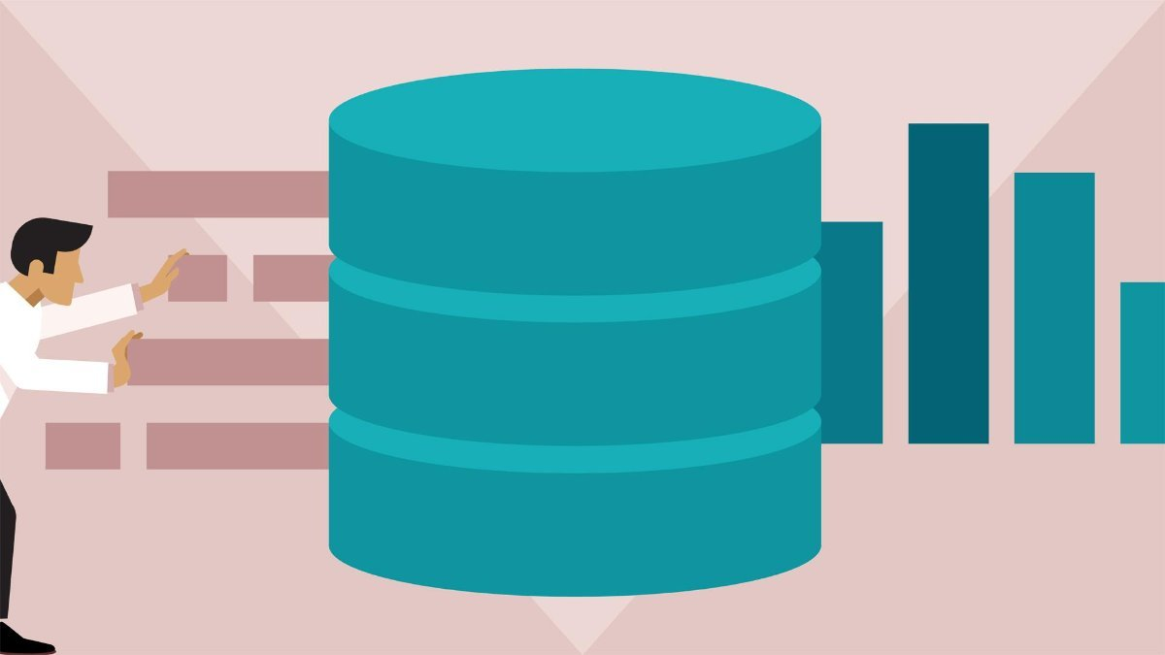
Content
1
Introduction to Linked Data
2
Data Preparation
3
Ontology
4
RDF
5
Data Linking
6
Application
7
Conclusion

Slide 3
Content
1
Introduction to Linked Data
2
Data Preparation
3
Ontology
4
RDF
5
Data Linking
6
Application
7
Conclusion

Slide 4

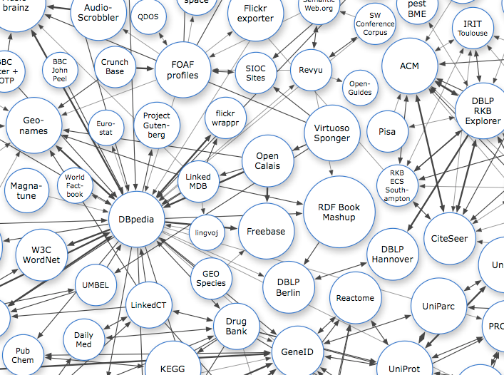
Introduction
The Linked Data
What is the linked data?

Slide 5
Content
1
Introduction to Linked Data
2
Data Preparation
3
Ontology
4
RDF
5
Data Linking
6
Application
7
Conclusion

Slide 6
Data Preparation
Data Selection
Linked with real-world entities
4
3
Data can come from other data sources
Available as a CSV file
2
1
Water quality

Slide 7
Data Preparation
Data Set Analysis
 | Variable | Type | Range
1 | ID | String | Unique
2 | Sample.samplingPoint | String | 320 choices
3 | Sample.samplingPoint.notation | String | 320 choices
4 | Sample.samplingpint.Label | String | 320 choices
.
.
.
.
.
.
16 | sample.samplingPoint.easting | Decimal | 301 choices
17 | sample.samplingPoint.northing | Decimal | 309 choices

Slide 8
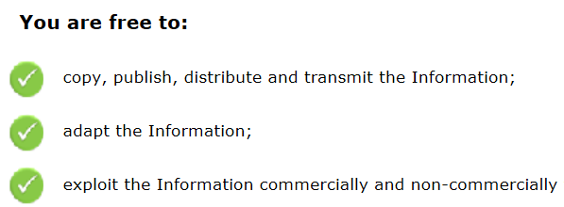
Data Preparation
License of the Data Source
Legal terms
B
Publisher & Rights holder
A
Publisher: Environment Agency
Rights holder: The Water Quality Archive

Slide 9
Data Preparation
Resource Naming Strategy
Name | URI
Domain | http://group05.com/
Ontological terms path | http://group05.com/ontology/Water-Quality#
Individuals path | http://group05.com/resource/
Ontological terms pattern | http://group05.com/ontology/Water-Quality#<term_name>
Individuals pattern | http://group05.com/resource/<resource_type>/<resource_name>

Slide 10
Content
1
Introduction to Linked Data
2
Data Preparation
3
Ontology
4
RDF
5
Data Linking
6
Application
7
Conclusion

Slide 11

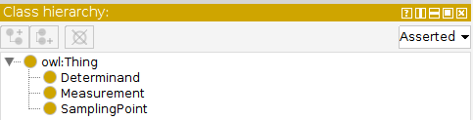
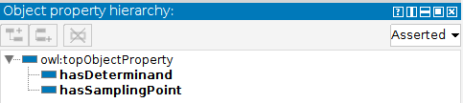
Ontology
Ontology 1
Ontology developed using Protégé

Slide 12
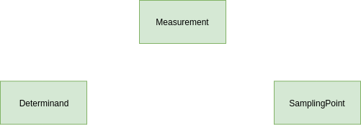
Ontology
Ontology 2
1. Define the classes

Slide 13
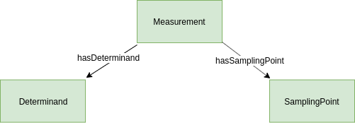
Ontology
Ontology 3
2. Define the object properties

Slide 14
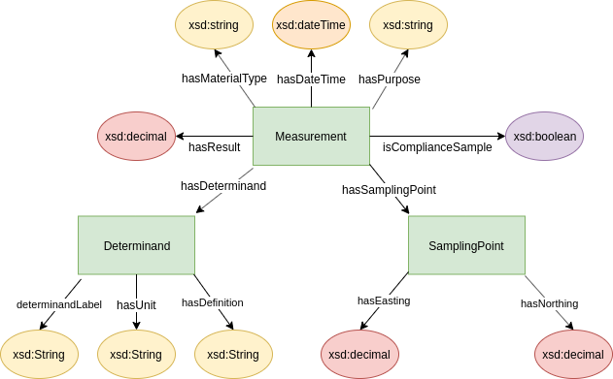
Ontology
Ontology 4
3. Define the data properties

Slide 15
Content
1
Introduction to Linked Data
2
Data Preparation
3
Ontology
4
RDF
5
Data Linking
6
Application
7
Conclusion

Slide 16
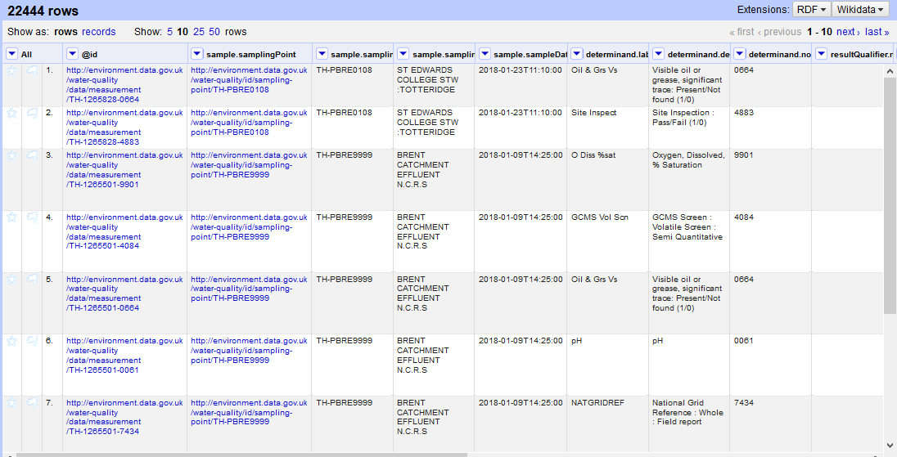
RDF
RDF Skeleton
Import the data and analyse it

Slide 17
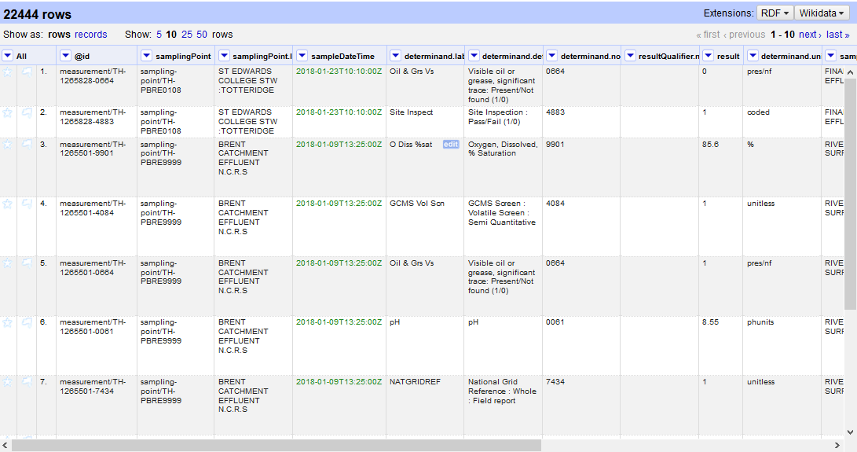
RDF
RDF Skeleton
Fixed dataset

Slide 18


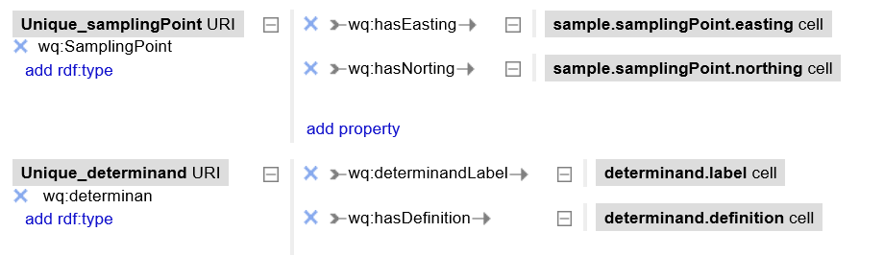
RDF
RDF Skeleton
1.
2. Add prefix:
3. Create the skeleton:
.
.
.

Slide 19
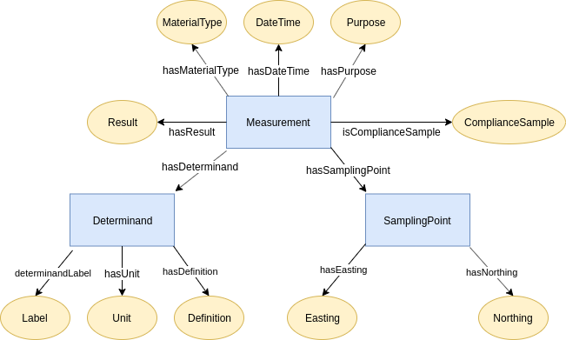
RDF
RDF Skeleton

Slide 20
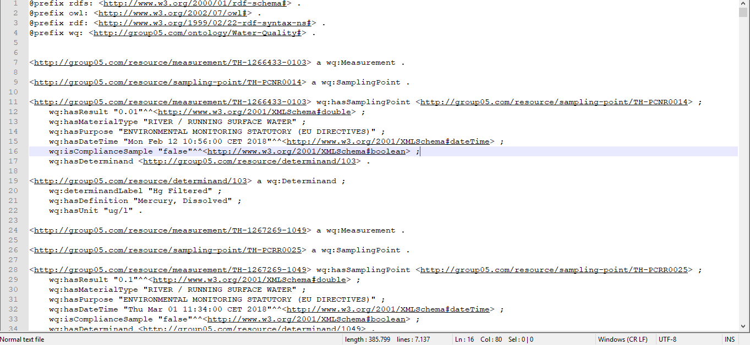
RDF
RDF Skeleton
Export to RDF using Turtle syntax

Slide 21
Content
1
Introduction to Linked Data
2
Data Preparation
3
Ontology
4
RDF
5
Data Linking
6
Application
7
Conclusion

Slide 22
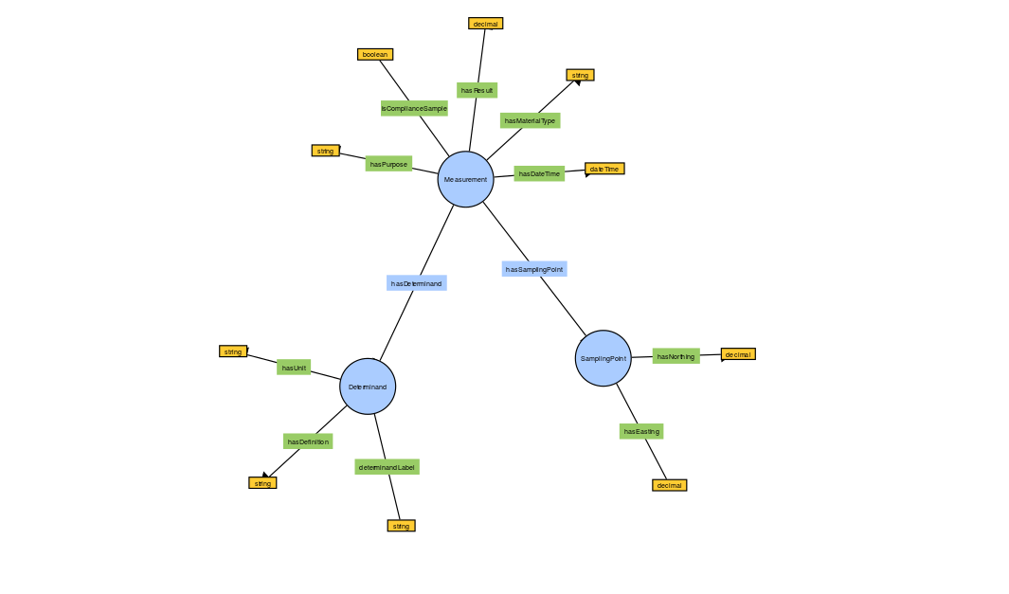
Data Linked
Linking the Data
Measurement, Determinand, and Samplingpoint

Slide 23
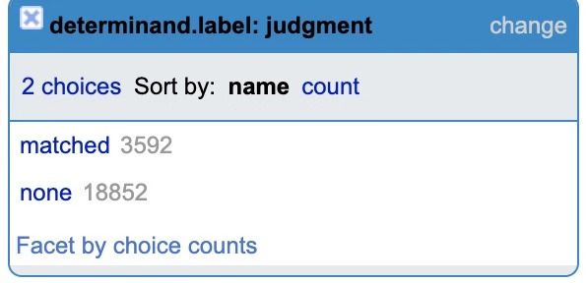
Data Linked
Linking the Data
1
Add a reconciliation service: Wikidata
Dataset
2
Start reconciling with Determinand
3
Select Chemical Compound from Wikidata

Slide 24
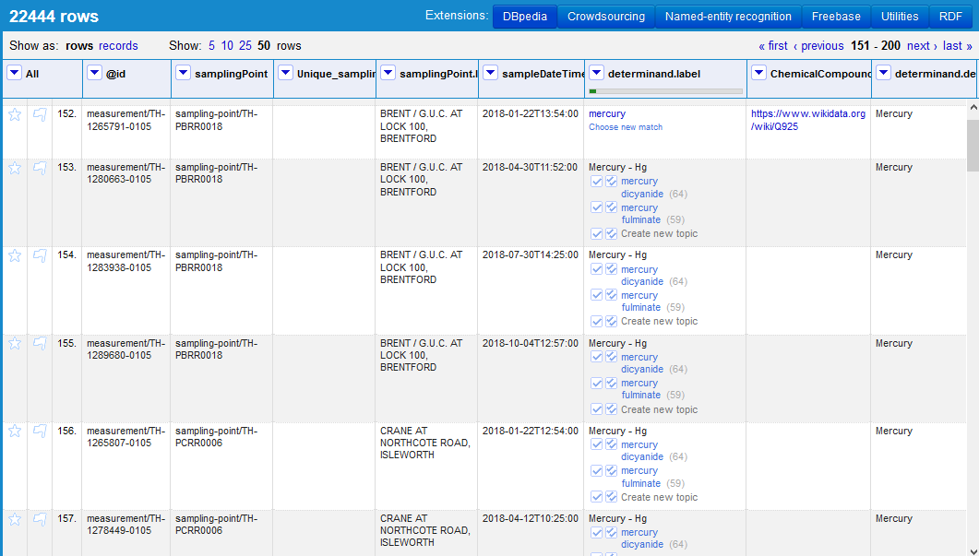
Data Linking
The Linked Data
Dataset after linking

Slide 25
Content
1
Introduction to Linked Data
2
Data Preparation
3
Ontology
4
RDF
5
Data Linking
6
Application
7
Conclusion

Slide 26
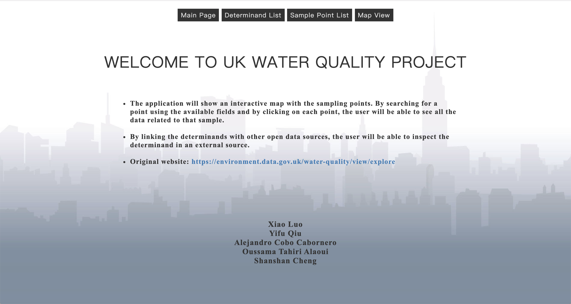
Application
Demonstration

Slide 27
Content
1
Introduction to Linked Data
2
Data Preparation
3
Ontology
4
RDF
5
Data Linking
6
Application
7
Conclusion

Slide 28
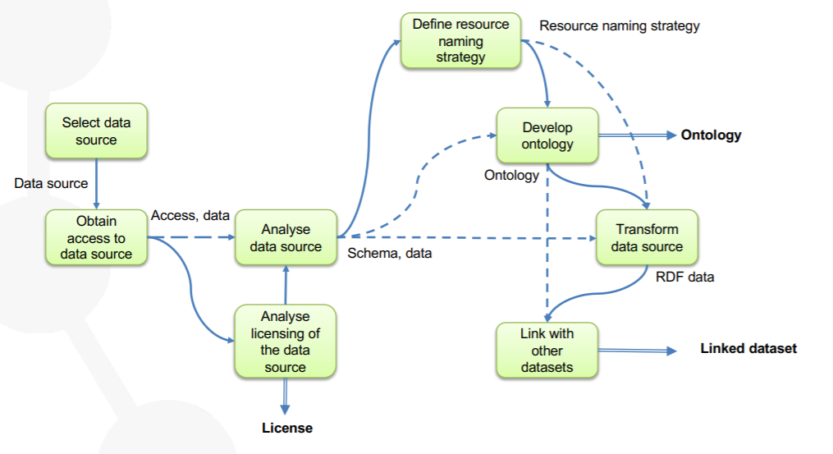
Conclusion
2.
1.
3. Java Application

Slide 29
University Master's Degree in Data Science
Open Data and Knowledge Graphs Course
Group 5 Assignment
Water Quality in London
Presented by:
Alejandro Cobo Cabornero
Oussama Tahiri Alaoui
Shanshan Cheng
Xiao Luo
Yifu Qiu
Academic Year 2019-2020

